Slide 1
ML-based Investment Analytical Tool
Meeting the needs of a changed Investment Clientele
Thong Bui, Sarah Kelley, Zhongqiao Jin, Natarajan Shankar

Slide 2

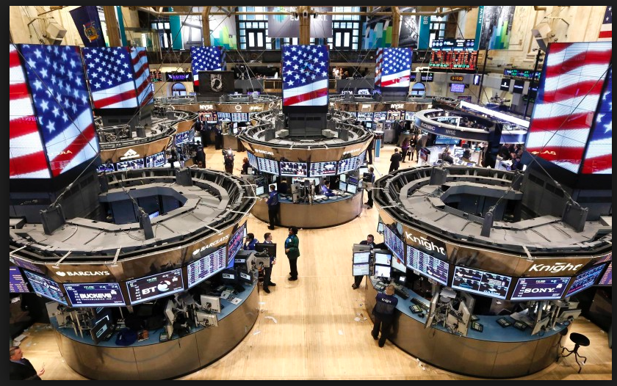
Millennials and Money Management
Millennials - the largest potential segment of the financial market
Millennials’ investment behavior different from that of prior generations
Articulation of a lack of trust in standard institutions
Demonstrate marked gravitation towards technology
Seek humble fee structure, socially responsible approaches
Prepared to make decisions, assume risk
To support the Millennials, financial Industry disruption is underway, driven by companies like RobinHood
“a stock brokerage built with the needs of a new generation in mind.”
Zero-fee trades
No storefront offices, research reports, analytical tools
Raised $176M, recently $100 Million at a $1.3B valuation
Our business driver:
Offer a financial application that complements this space
Why us?
Notes:
Shankar

Slide 3

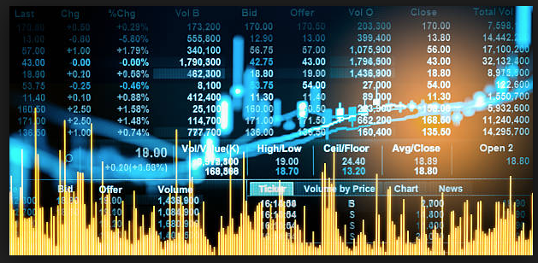
Data Science in the New Market
Data forms the basis of investment decisions
Multiple forces move markets and decisions, all characterized with data:
Quantitative
Fundamentals: PE Ratio, Revenue Growth
Economic Data: Inflation, Unemployment, Monetary
Behavioral: Psychology, Social Sciences
Textual: News, Whispers, Politics
Data is available for consumption but is voluminous and in raw form
Needs tools and expertise to leverage, for insight
Apps that augment the new business model have relevance
Intelligence extraction from multiple forms of data
Complex models but complexity hidden from the user
Provide a simple tool
Leading to the birth of:
“Investment Analytical Tool”
Notes:
Shankar

Slide 4
Approaches
Product Work Flow
Approaches:
We are providing a web-based solution to recommend individual stocks for the investors. The solution is leveraging both time series/static numeric data as well as NLP data to predict the future stock price and recommend it to the user based on their risk aversion
Highlights:
Enhanced input feature coverage
News sentiment feature inputs
LSTM-based predictive model
Cross validated results
Risk exposure caveat
Interactive UI allow user to select Risk aversion
Source
Company Fundamental Data
Stock Price Data
Company News Data
Sentiment
Score
Algorithm
LSTM Predictive Model
Recommendation
Stock recommendation based on user’s request
Notes:
Zhongqiao
We will dive into details in the following slides

Slide 5
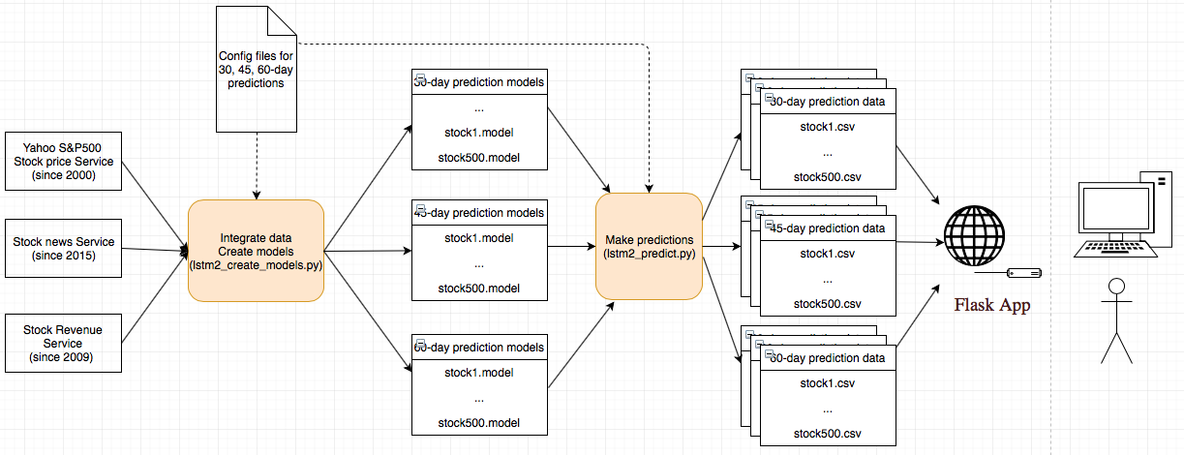
Detailed System Architecture
Notes:
Thong:
Main github: https://github.com/thongnbui/MIDS_capstone
Specific codes for:
Lstm2_create_models.py
lstm2_predict.py

Slide 6
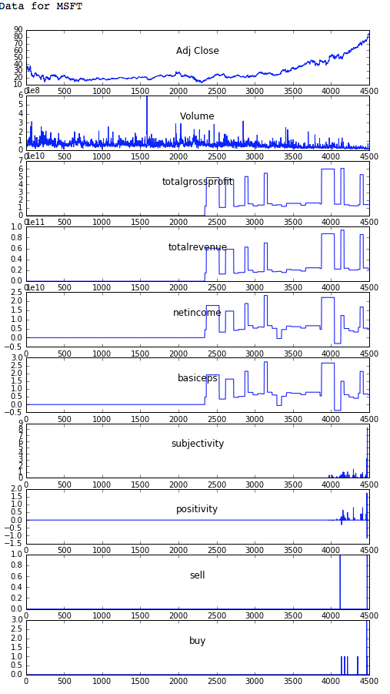
Data Analysis
Data Analysis:
Stock data starts from 2000: Adj Close, Volume
Revenue data starts from 2009:
Can we map Q1, Q2, Q3, Q4, FY to correct dates?
Keep totalgrossprofit, totalrevenue, netincome, basiceps
operatingrevenue is 0s so we decided to drop them
News data starts from 2015
subjectivity, positivity, sell, buy
buy, sell are sparse.
Data quality concerns
We decided to use the latest start date 2015

Slide 7
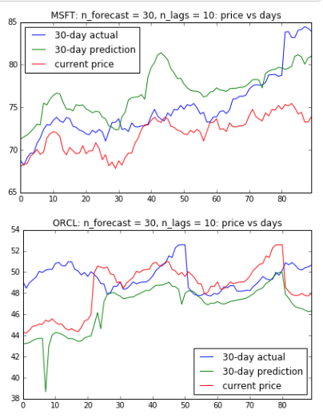
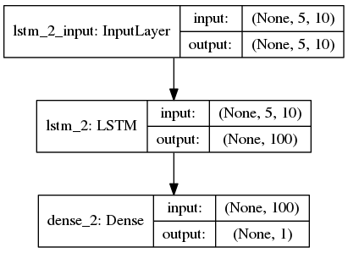
Models using time-series and LSTM
For each stock:
Combine the 3 datasets since 2015
Create time-series dataset to predict different long-term prices: 30, 45, 60 days
Train data: before the last 90 days. Test data: last 90 days
LSTM: Recurrent networks, of which LSTM is one of the most successful, are generally useful when you're dealing with a time series.
Very good at holding long term memories
Long term dependencies in the network is done by gating mechanisms
Cross-validation against test data (last 90-day)
Minimize overfitting: early stopping (see details)
Models & Predictions
Notes:
Thong - More on LSTM:
In other words, the prediction of nth sample in a sequence of test samples can be influenced by an input that was given many time steps before.
Preserving the long term dependencies in the network is done by its Gating mechanisms. The network can store or release memory on the go through the gating mechanism

Slide 8
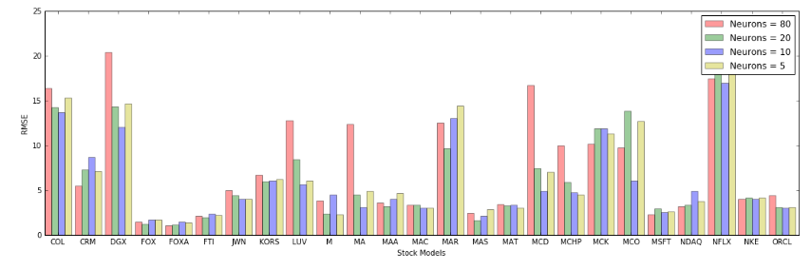
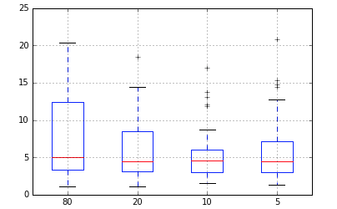
Models & Predictions (cont’d)
Parameter Tuning
We pick some parameters to tune for optimal RMSE and use them in config file for modeling
Ex: The optimal number of neurons for models to predict 30-day stock prices can be different from 45 or 60-day models (see the end of this notebook for more details)
Notes:
Thong -
box and whisker plot

Slide 9
Results & Evaluation Criteria
Results:
The solution provides recommendation with a list of 10 stocks out of S&P 500 pool to users based on a combination of predicted return and the accuracy of the prediction. The solution also considered risk aversion and the expected return period.
Evaluation:
Used RMSE (root-mean-square error) to measure the accuracy of prediction. RMSE is a frequently used measure of the differences between values predicted by a model or an estimator and the values actually observed.
Leveraged SD (standard deviation) to measure the volatility of stocks during this period - how much the prediction price is changed during this period
Low risk: predicted SD < 0.25 percentile
Medium risk: predicted SD is between [0.25, 0.75]
High risk: predicted SD > 0.75
Used S&P 500 index as the benchmark to measure the historical prediction efficiency.
Predicted Return
Recommend
Not Recommend
RMSE
Notes:
Zhongqiao
To avoid misleading investors
Simplify the process of picking the best stocks from a large pool of S&P500 stocks
Provided multiple options for different investor
Meanings of RMSE and Standard Deviation (SD) during this period (last 90 days)
RMSE measures accuracy of prediction
The smaller the number, the more accurate the prediction measured against actual values
SD measures the risk of this stock during this period - how much the prediction price is changed during this period
Low risk: predicted SD < 0.45 percentile
Medium risk: predicted SD is between [0.45, 0.75]
High risk: predicted SD > 0.75
Pick the top stocks: a combination of average predicted gains and RMSE
Leveraged S&P 500 index average return as a benchmark of the comparison

Slide 10
User Interface Architecture
Interactive application to allow users to input risk and timeframe preferences
Flask served over a gunicorn webserver
connection to Python-based backend model
Dynamic HTML pages
Notes:
Sarah

Slide 11
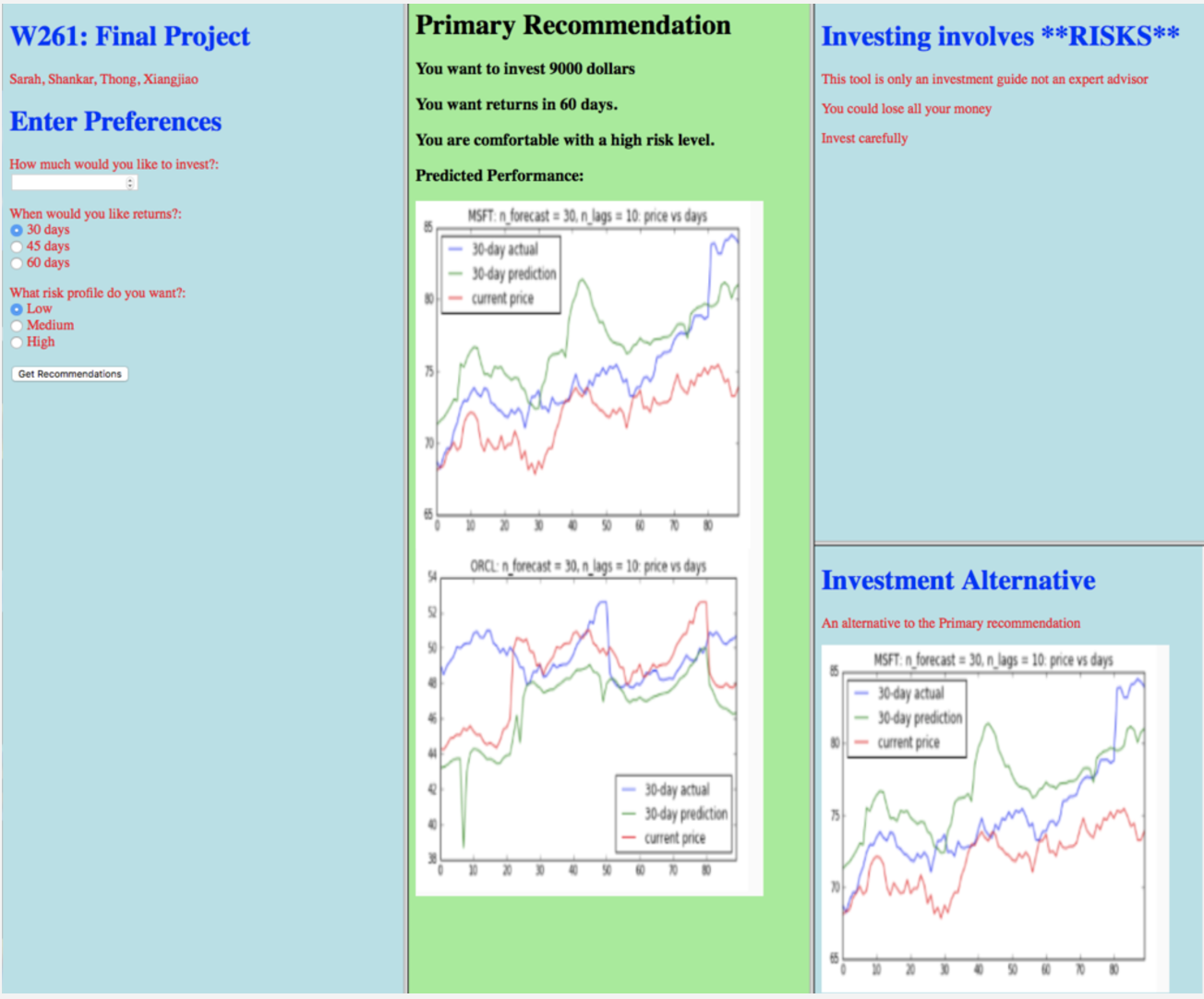
Original User Interface Design
Notes:
Sarah-

Slide 12
User Testing and Feedback
User testing with 10 millennials
Demographics:
21-36; all college educated, 6 women 4 men
None in the financial industry or DS
Core feedback:
Our interface is messy and doesn’t look professional -- “honestly it looks a little like a project from a HTML 101 class”
Don’t understand how the model works or why they should trust it
Found the graph extremely confusing
Mixed feedback on level of detail: got both people wanting more detail and feeling like there was too much data
Notes:
Sarah

Slide 13
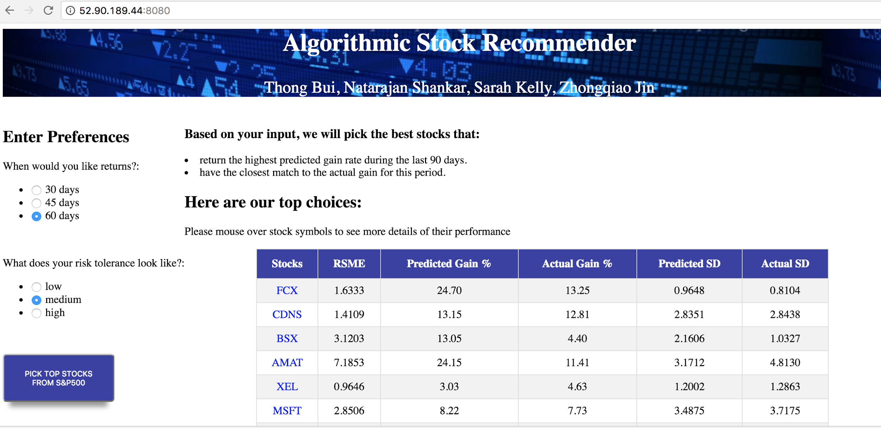
Improved UI
Or
Notes:
Sarah

Slide 14
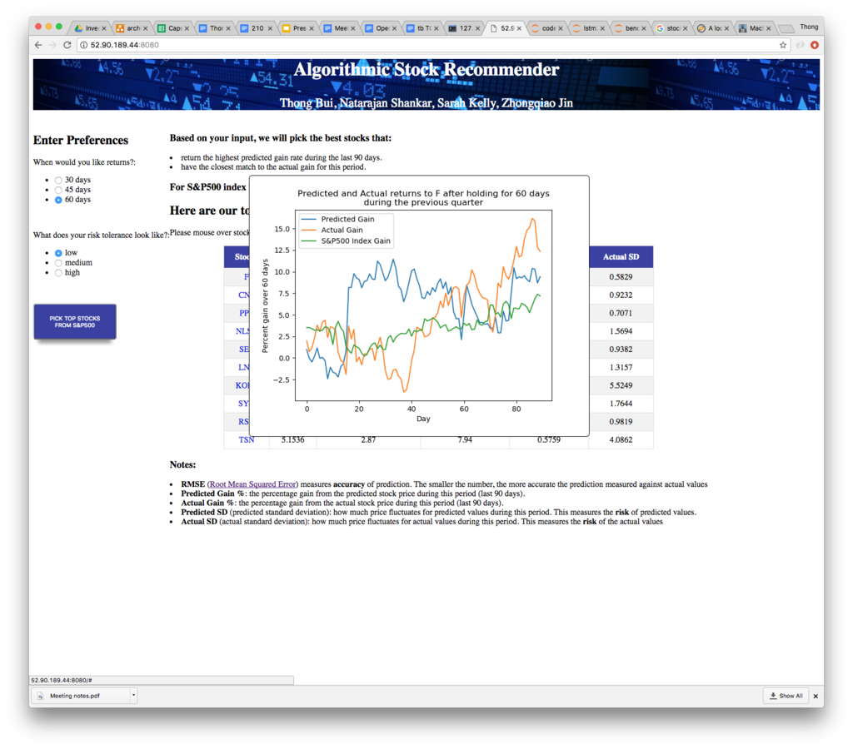
Improved UI
Notes:
Sarah

Slide 15
How we communicate
value
Core question is how do we show our potential users why they should trust us
Limitations:
Technical knowledge of audience
Balancing demonstrating value with not being overly certain
Main tactic: written page describing at a higher level, with details on request
Overview of process in friendly language
Describe model testing/verification
Describe limitations
Core feedback:
Reading model description test, users generally felt that they had a good basic understanding
“I feel like the website isn’t trying to trick me -- you are upfront about the uncertainty”
“Can I use this now?” (I said no)
Notes:
Sarah

Slide 16
Demo
We have webapp ready
Observations: For the last 90 days:
Within the same time period: higher risk yields higher returns
Longer time period yields higher returns
Ex: returns of 60 days > 45 days > 30 days

Slide 17
Next steps
What questions are still open? Where might you go from here?
Data quality limitation:
From 2015
Pay for some financial services (expensive) to get better quality of news and quarterly reports
We can use data before 2008 stock crash -> better for training and predictions
Better sentiment analysis software
Better architecture:
store data in some DB
More sophisticated UI:
allow user to pick a stock, input actual today’s price and other data to predict price for 30, 45, 60 days

Slide 18
Thank you!
Q&A
Github: https://github.com/thongnbui/MIDS_capstone
documents: all the documents created for this project
WebApp: flask webapp code
code: all the back-end codes
config: all the config files used
References:
https://machinelearningmastery.com/

